Slide 1
Lecture 3
Relation, POSET, Lattice
Course: Discrete Mathematics

Slide 2






Slide 3






Slide 4





Slide 5





Slide 6







Slide 7


Slide 8






Slide 9






Slide 10



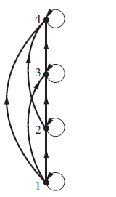

Slide 11

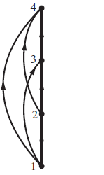

Slide 12

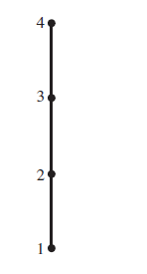



Slide 13


Slide 14




Slide 15


Slide 16



Slide 17







Slide 18






Slide 19



Slide 20
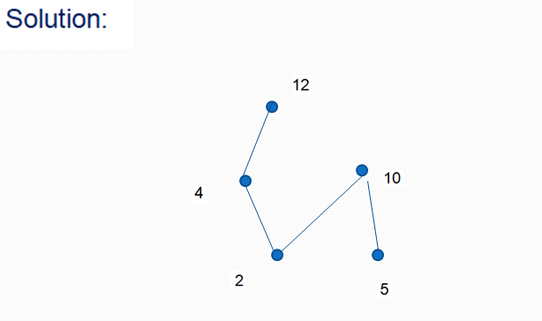

Slide 21



Slide 22


Slide 23



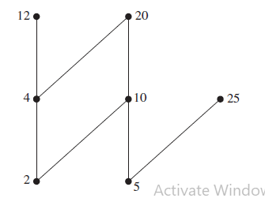


Slide 24



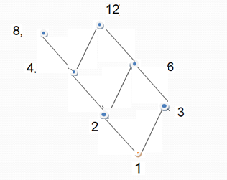



Slide 25





Slide 26

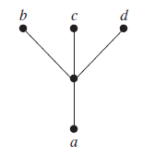


Slide 27
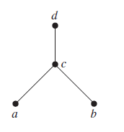

Slide 28
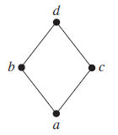

Slide 29
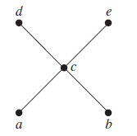


Slide 30




Slide 31


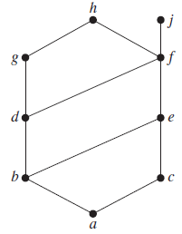

Slide 32
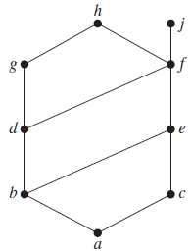



Slide 33




Slide 34


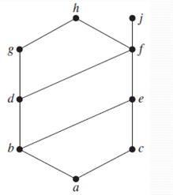



Slide 35




Slide 36

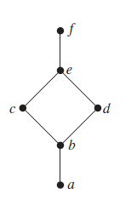
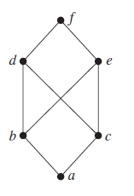
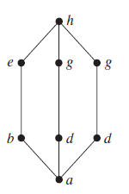

Slide 37

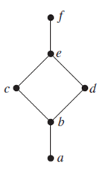

Slide 38
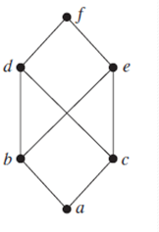

Slide 39
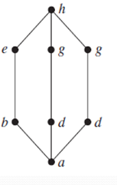

Slide 40




Slide 41


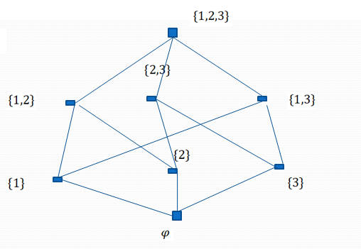


Slide 42






Slide 43


Slide 44



Slide 45


Slide 46



Slide 47


Slide 48
Thanks for watching
Have a nice day

